Slide 1
Importance of Code Reviews and Pair Programming
Presented by – Manish Jha
Data Scientist

Slide 2
Agenda
Why writing code isn’t just about making it work
Importance of collaboration in software development
What we'll cover today:
Code Reviews (What, Why and How)
Pair Programming (What, Why and How)
Tools, Benefits, and Best Practices

Slide 3
Why Writing Code Isn’t Just About Making It Work
Maintainability: Code should be easy to read, understand, and update.
Scalability: Good code can handle growth and new requirements smoothly.
Collaboration: Others (or future you) should easily pick up and work with your code.
Quality: Clean code reduces bugs, improves performance, and builds trust.
Professionalism: Writing elegant, thoughtful code reflects a mature, responsible developer.

Slide 4
Importance of Collaboration in Software Development
Better Solutions: Diverse ideas lead to more creative and effective outcomes.
Faster Problem-Solving: Teams solve complex issues quicker together.
Knowledge Sharing: Collaboration helps everyone grow and learn.
Higher Code Quality: Peer reviews and discussions catch mistakes early.
Stronger Team Culture: Working together builds trust, ownership, and motivation.

Slide 5
What is Code Review? Code Review is a collaborative process where developers examine each other’s code before it becomes part of the main codebase.
A peer evaluation of code changes before they are merged.
Focuses on the code itself, not the coder—reviewing logic, syntax, and structure objectively.
Involves reviewing new features, bug fixes, refactors, or any change made to the codebase.
Encourages consistent and organized collaboration across the development team.

Slide 6
Why Code Reviews Matter? Code reviews are a critical practice in software development that bring multiple long-term benefits to both the codebase and the development team. Here's why they matter:
Catch bugs early
Improve code quality and readability
Share knowledge across team
Reinforce Coding Standards
Encourages collaboration

Slide 7
How to Do Code Review? A well-executed code review goes beyond just reading code—it involves structured, thoughtful inspection with the goal of improving the codebase and supporting team growth.
Understand the Context
Review Code in Small, Manageable Chunks
Look for logic issues, style, performance, security
Give Constructive, Clear Feedback
Ask questions, suggest improvements
Use a checklist if needed (e.g., “Are there enough tests?”, “Is this DRY?”)
Follow Up & Collaborate

Slide 8
Common Mistakes in Code Review
Taking feedback personally
Using an overly harsh or critical tone
Reviewing too much code at once
Skipping the context
Not asking questions
Lack of follow-up
Overlooking non-code aspects

Slide 9
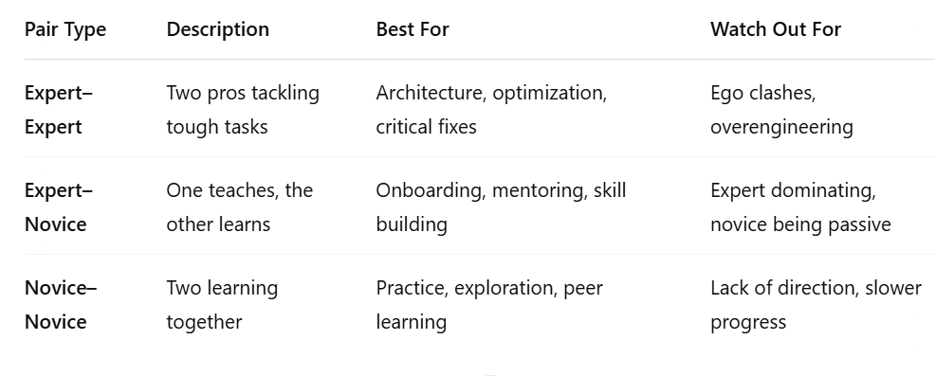
What is Pair Programming ? Pair Programming is a software development technique in which two developers work together at one workstation on the same coding task. It is one of the core practices of Extreme Programming (XP), a methodology under the Agile umbrella. Various Types of Pairs:

Slide 10
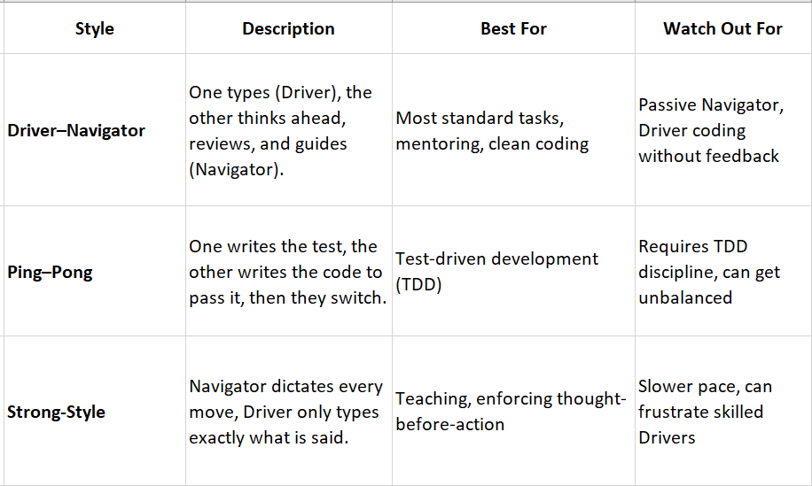
How Pair Programming works? In pair programming, both developers share the same context and goal but perform complementary roles: Style of Pair Programming:

Slide 11
Why Pair Programming Works? In pair programming, two developers work together at one workstation, sharing the same goals and context. By performing complementary roles, they combine their strengths, which leads to faster problem-solving, better quality code, and increased skill development. Here’s why it’s effective:
Real-time collaboration & feedback
Faster debugging
Continuous code review
Skill sharing & mentoring
Better design decisions
Enhanced focus & discipline
Improved team communication
Effective knowledge transfer
Diverse problem-solving perspectives
Higher code confidence & quality

Slide 12
Best Practices for Pair Programming:
Communicate clearly
Switch roles regularly
Take breaks
Be respectful and patient
Agree on goals beforehand
Embrace diverse approaches
Use timeboxing to stay on track
Be open to feedback
Stay focused on the task
Leverage collaboration tools effectively
Respect personal space and comfort
Check in regularly on progress and approach

Slide 13
Key Takeaways
Code Reviews
Enhance code quality through diverse perspectives
Foster continuous learning and team growth
Pair Programming
Strengthens collaboration and technical skills
Enables real-time problem solving and faster feedback
Embrace Feedback and Collaboration
Treat feedback as an opportunity for improvement
Early collaboration leads to better results and fewer mistakes
Adopt Best Practices Early
Start applying code reviews and pair programming in student projects
Build habits that prepare you for real-world software development

